Slide 1
INFOSYS SPRINGBOARD INTERNSHIP PROGRAM
Multi-Agent Contract Analysis System

Slide 2


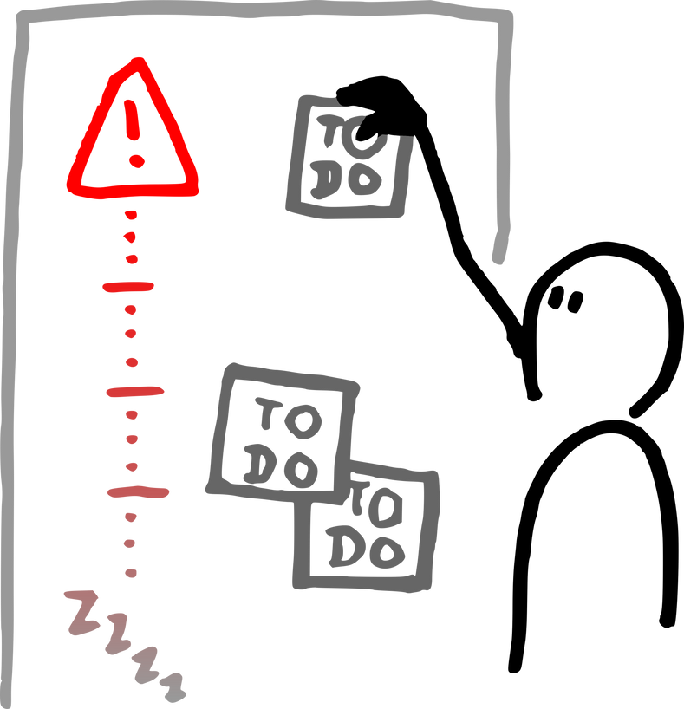
Introduction
Project Overview
Problem
Solution
Why It Matters
Manual contract review is slow, error-prone, and bottlenecked by human expertise in specific domains (e.g., legal vs. financial). Traditional tools (like standard OCR) can read text but lack the intelligence to understand complex risks or context.
An Intelligent Multi-Agent System that uses a "Planning Module" to coordinate specialized AI agents (Legal, Finance, Compliance & Operation). These agents work simultaneously to parse, classify, and risk-assess documents using LangGraph and LangChain.
This tool makes organization easy. It turns slow, manual work into a fast, automated process, ensuring you don't miss critical risks due to tiredness or a lack of specific knowledge.
2

Slide 3

Introduction
Project Objective
Main Goal
To develop an automated, intelligent system that drastically reduces the time and error rate of legal contract reviews by using a Multi-Agent AI architecture. The system aims to replicate a human review board by assigning specific sections of a document to specialized "expert" agents that work in parallel to identify risks.
Supporting Objectives
Automate Document Parsing
Classify contracts into relevant domains
Use AI agents for specialized analysis tasks
Enable Parallel Risk Assessment
Provide structured and interpretable output
3

Slide 4
Concept Development
Technology Stack
Packages & Libraries Used
Programming Language
LangGraph (Stateful multi-agent workflows).
LLM Framework: LangChain (Prompt engineering and integrating various tools).
Database: Pinecone and chromadb(Vector storage for semantic search/retrieval).
Streamlit: Building and deploying the interactive web frontend to interact with the application.
Backend: Python (API integration and logic).
Parsing: Unstructured/PyPDF for text extraction.
Python 3.9+
4

Slide 5



Target Audience
Who We Designed For
Target User
Their Challenges
Corporate Legal Teams
Finance & Procurement Departments
Compliance Officers
Operations Managers
Teams are drowning in routine paperwork, creating massive bottlenecks that slow down deals.
Disconnected teams (Legal vs. Finance) often miss cross-domain risks that fall between the cracks.
Human attention fades after hours of reading dense text, leading to critical errors.
Outsourcing routine contract reviews to external firms is prohibitively expensive.
Different human reviewers interpret risks differently, leading to a lack of standardization.
5

Slide 6
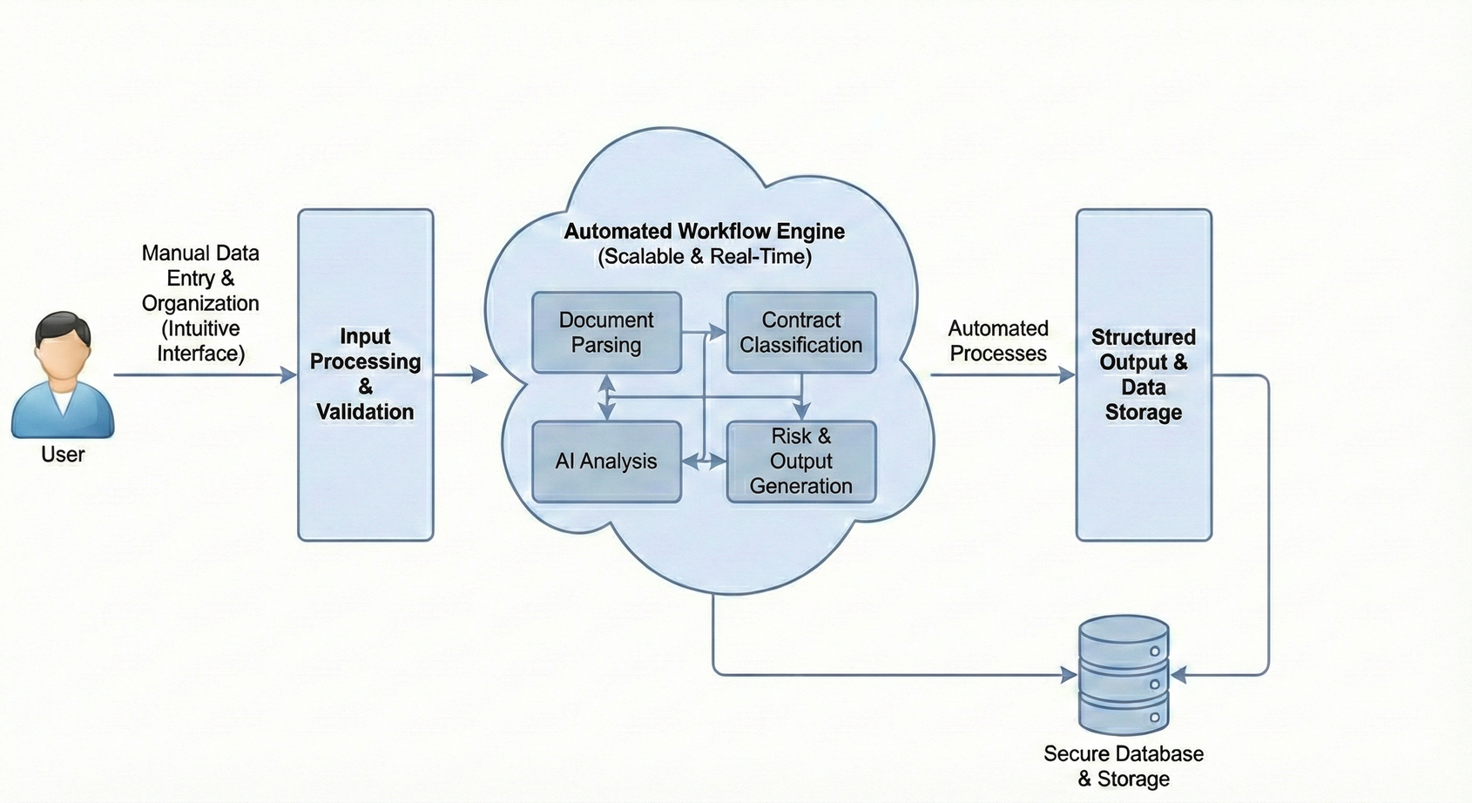
Concept Development
System Architecture
6

Slide 7
Concept Development
Specialized AI Agents
Legal Agent
Finance Agent
It focuses strictly on the binding terms and legal language of the contract. Jurisdiction clauses, termination rights, and intellectual property ownership.
This agent acts as your financial auditor. Payment schedules, late fees, penalty clauses, currency fluctuations, and tax obligations. It prevents financial loss.
Compliance Agent
Operations Agent
It ensures the contract adheres to external laws and internal company policies. It saves the company from massive government fines and reputational damage by ensuring no illegal or non-compliant activities are agreed to in the text.
This agent is the project manager. It looks at the practical side of how the work will actually get done. It ensures the contract is realistic.
7

Slide 8
Key Features
Document Parsing & Ingestion Strategy
1
2
3
4
Ingestion
API accepts file uploads (PDF, DOCX, IMG).
Extraction
Uses libraries (e.g., PyPDF, Unstructured) to strip text from binary formats.
Cleaning
Removes noise like page numbers, headers, footers, and watermarks.
Chunking
Splits continuous text into smaller, overlapping segments (e.g., 500 tokens) to fit LLM context windows.
Output
Clean JSON objects containing text chunks and metadata (page numbers), ready for embedding.
8

Slide 9
Key Features
The Planning Module
Concept: This module acts as the project manager. It doesn't read the whole contract itself; instead, it looks at the document and decides who needs to read what.
How it Works:
Input: The module receives the document type (e.g., "Service Agreement") and the user's high-level request.
Decomposition: The LLM breaks the request into sub-tasks.
Example: "Check for financial penalties" $\rightarrow$ Assigned to Finance Agent.
Example: "Check for GDPR compliance" $\rightarrow$ Assigned to Compliance Agent.
Routing: It generates a structured JSON Plan that tells LangGraph which agents to activate.
9

Slide 10
Key Features
Parallel Processing Implementation
Concept: Instead of agents waiting in a line (Agent A $\rightarrow$ Agent B $\rightarrow$ Agent C), they all work at the exact same time.
The Technical Shift:
Sequential (Traditional): Legal Agent finishes, then passes data to Finance. If Legal takes 5 minutes, Finance waits 5 minutes. Total time = 10 mins.
Parallel (Our Approach): The Planning Module triggers Legal and Finance simultaneously. Total time = 5 mins (whichever is longest).
Implementation with LangGraph:
We use a "Fan-Out" architecture in the graph. The state splits into multiple branches, and each agent processes its own branch independently.
At the end, a "Join" node aggregates all the results into one final report.
10

Slide 11
Reflections & Growth
Future Scope
Human-in-the-Loop Interface: Developing a UI where legal experts can validate or reject AI findings to continuously train the model.
Multi-Lingual Capabilities: Extending the Planning Module to handle and translate cross-border contracts (e.g., in Hindi, German, or Spanish).
CLM Integration: API connectors to link directly with corporate tools like Salesforce or DocuSign for seamless workflow automation.
11

Slide 12
Reflections & Growth
Conclusion
Proof of Concept: Successfully validated that a Multi-Agent System (vs. a single LLM) significantly improves accuracy by assigning "specialist" roles (Legal, Finance, Compliance).
Technical Achievement: Orchestrated a complex, parallel workflow using LangGraph, demonstrating real-time coordination between 4+ autonomous agents.
Business Value: The system drastically reduces "Time-to-Insight" for contract review, transforming a manual, multi-day process into an automated workflow that takes minutes.
Reliability: Integrated Pinecone (Vector DB) to eliminate hallucinations, ensuring agents only analyze text actually present in the documents.
12

Slide 13
Thank You

